Slide 1
Substitution and Elimination Reactions
SN2,SN1, EN2, EN1 REACTIONS

Slide 2
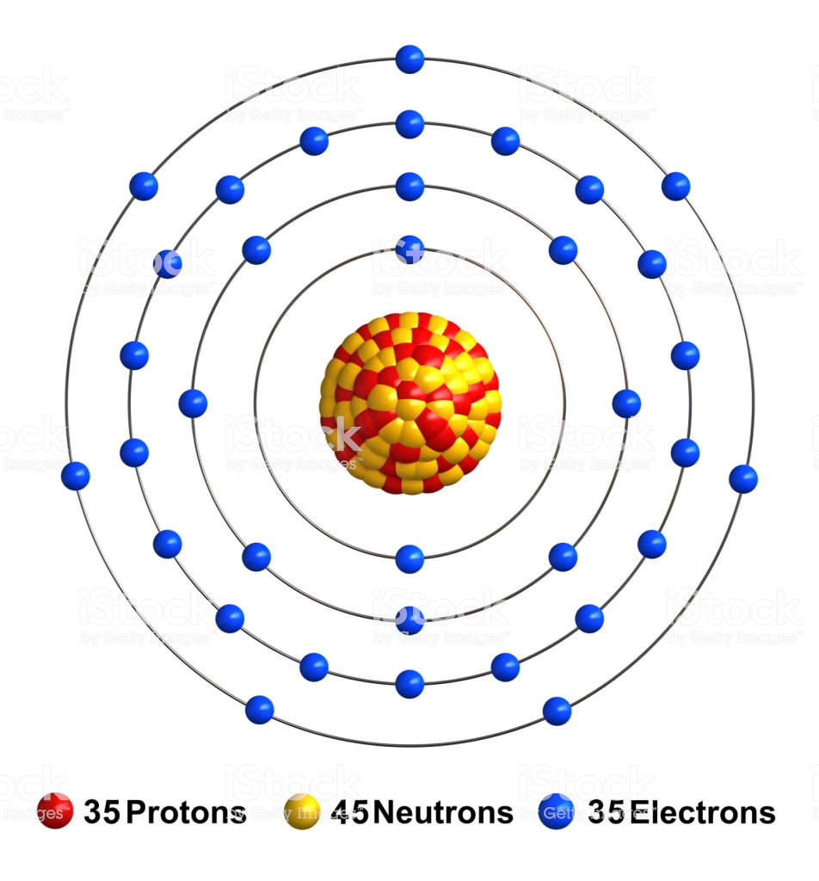
SN2 Reactions
A reaction involving an alkyl halide.
Halogen atom is substituted by a nucleophile.
The saturated carbon participates in the rxn.
Bromine (nucleophilic in ionic
form)
Notes:
A SN2 reaction is a type of chemical reaction in organic chemistry where a nucleophile (nuclear-loving) that is negatively charged substitutes an atom of a halogen which is bonded to the central carbon of an alkyl halide molecule. The saturated carbon in the organic compound is the one that participates in the reaction.

Slide 3
SN2 Reactions
“Nuclea-loving” particles
Halides (Fluoride, Bromide, Chloride)
Alkoxy group (RO–)
Hydrogen sulphide(H2S)
Water (H20)
Ammonia (NH3)
Cyanide (CN-)
Notes:
Nucleophiles that can displace the halogen include halide, alkoxy group hydroxyl group, hydrogen sulphide, water, ammonia and cyanide ion

Slide 4
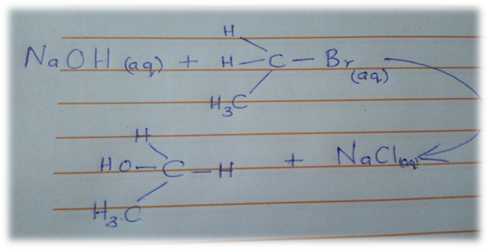
Example of a SN2 Reaction
CH3CH2Br(aq)+NaOH(aq)⇌CH3CH2OH(aq)+NaBr(aq)
Notes:
One particular example of a SN2 reaction is that involving sodium hydroxide and ethyl bromide. The reaction yields Ethanol and sodium bromide.

Slide 5
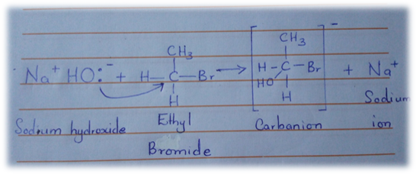
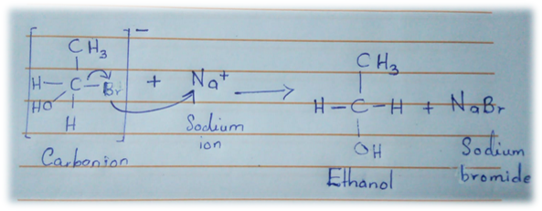
Mechanism
Step 1:
Step 2 :
Notes:
The mechanism involves the attack of the ethyl bromide (substrate) by the hydroxyl (nucleophile) from the backside (180 degrees approach). Carbon-halogen break as the carbon-nucleophile bond forms.
Step 1: Backside attack by the nucleophile (OH) to form the intermediate compound (Carbanion)
The second step involves the simultaneous breaking of carbon-bromide bond to form ethanol and sodium bromide.

Slide 6
Conditions
Good leaving groups (weak bases).
Predominantly involve primary and secondary alkyl halides.
Reaction rate enhanced by polar aprotic solvents.
Backside attack .
Notes:
These reactions require good leaving groups such as weak bases.
SN2 reactions occur in primary and secondary alkyl halides but not tertiary halides as the carbon is almost immune to nucleophilic attack.
Polar aprotic solvents enhance the reaction rate hence can be applied. However polar protic solvents hinder reactivity as the latter hinder the hydroxyl from participating in the reaction.
The nucleophile attacks primarily from the backside because the front side is obscured by the electron-rich bromide (leaving group).

Slide 7
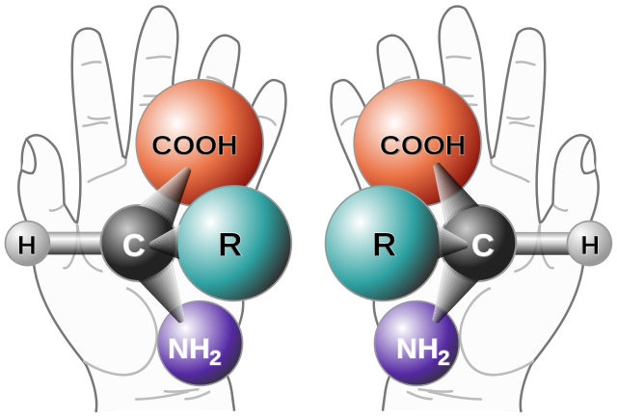
Effect on Stereochemistry
The backside attacks of SN2 reactions result in the inversion of the product in comparison to the substrate.
The Lecturio Online Medical Library , 2016, Stereochemistry

Slide 8
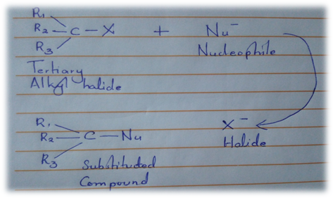
SN1 Reactions
Notes:
SN1 reactions resemble SN2 reactions in that the nucleophile attacks the carbon of an alkyl halide in a nucleophilic substitution reaction; however, the reaction is stepwise and not simultaneous as with SN2 reactions.

Slide 9
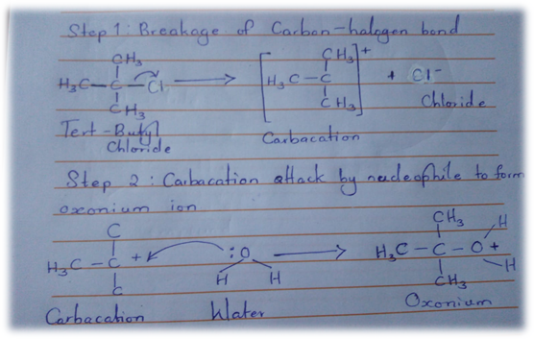
Mechanism
Notes:
The first step involves the formation of the carbacation by the removal of the leaving group (when carbon-halogen bond is broken. In the second step, the carbacation is attacked by the nucleophile to form and intermediate (oxonium). In the final step deprotonation of the protonated nucleophile occurs once more to form hydronium ion and alcohol.

Slide 10
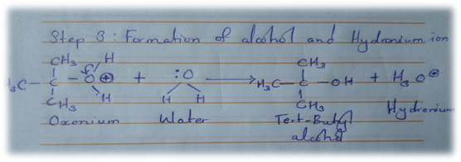
Mechanism

Slide 11
Conditions
Suitable leaving group such as a base
Polar protic solvents increase reactivity
Primary haloalkanes don’t undergo the reaction due to instability.
Notes:
As with SN2 reactions, SN1 reactions do require a suitable leaving group that dissociates easily. As such a weak base makes a good leaving group.
The order of reactivity of halogens towards these reactions is I>Br>Cl>F.
Polar protic solvents (water or alcohol) immensely accelerate the reaction as they help in formation of carbacation.
Primary haloalkanes do not undergo SN1 reactions as the intermediate carbacation is hard to produce owing to its instability

Slide 12
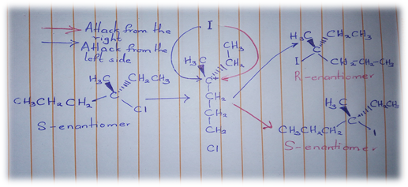
Effects on Stereochemistry
Notes:
The carbacation formed in the first step has a trigonal planar conformation thus it has equal chances of being attacked from all two sides. This normally yields enantiomers that are both left and right-handed in equal proportions.

Slide 13
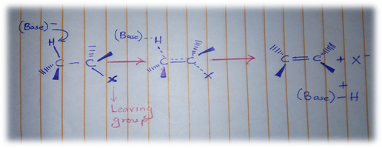
EN2 Reactions
Elimination of a substitute
One-step mechanism
Bi-molecular (second order reaction)
Notes:
An EN2 reaction is an organic reaction where one substitute is removed/ eliminated from the substrate by a one-step mechanism. This reaction is bi-molecular, that is, a second order reaction.

Slide 14
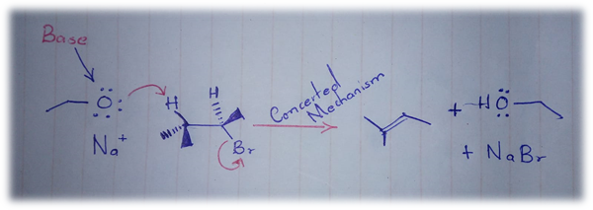
Mechanism
Concerted mechanism. (removal of proton and leaving group simultaneously)
Notes:
In this reaction, a strong base removes the proton from the alkyl halide as seen above while simultaneously removing the leaving group that is oriented anti to the proton (180 degrees). Such a mechanism is called a concerted mechanism.
An example of such a reaction is illustrated below where tertiary-butylbromide is acted upon by a base.

Slide 15
Conditions
Substrates with anti-planar conformation are necessary.
Favoured by high entropy.
Requires a strong base.
Affected by base and substrate concentration.
Polar aprotic solvents.
Notes:
Since the reaction results in the formation of a pi bond, the hydrogen and leaving group have to be antiplanar as this conformation requires lesser energy than synperiplanar hence more favourable.
These reactions are favored by higher temperatures (high entropy)
A base strong enough is required to remove the weakly bonded hydrogen.
Mostly undergone by primary alkyl halides; secondary alkyl halides need special conditions.
The reaction rate is influenced by the base and the substrate
Polar aprotic solvents are normally suitable for this reaction.

Slide 16
Effect on Stereochemistry
These reactions require the leaving group to be ant-planar (180 degrees) to the proton that is to be removed by the strong base.

Slide 17
EN1 Reactions
Unimolecular reactions.
Two step reaction involving
Ionization
Deprotonation
Notes:
The EN1 reaction is a unimolecular two-step elimination reaction that involves ionization and deprotonation. In ionization, a carbacation intermediate is produced from the break-down of the carbon and halogen bond. The carbacation is further deprotonated.
Tertiary substrates are more favored in this reaction.

Slide 18
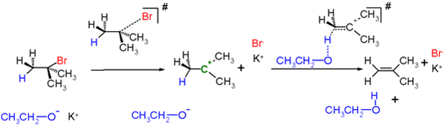
Mechanism
Notes:
The following reaction is an example involving Tertiary butyl bromide and potassium ethanolate (C₂H₅KO). The reaction results in the formation of 2 butene.
Firstly, the leaving group is removed forming a carbacation. Secondly the proton is removed to form an alkene.
The reaction is dependent on substrate concentration and as such the removal of the leaving group is the rate limiting step.

Slide 19
Conditions
Favoured by a slightly acidic environment.
High temperature accelerates the reaction.
Favoured by steric hindrance.
Notes:
The mechanism is favored by acidic conditions and high temperature. Thus, a strong base is not required.
The reaction is also favored by stearic hindrance hence preferred over substitution reactions when the substrate is bulky.
Bases that have steric bulkiness favor EN1 reactions.

Slide 20
Effects on Stereochemistry
The reaction does not have any anti-planar or peri-planar requirements. However it is normally accompanied by the rearrangement of carbacations.

Slide 21
References
Britannica, T. Editors of Encyclopaedia (2011, December 16). Elimination reaction. Encyclopedia Britannica. https://www.britannica.com/science/elimination-reaction
Hamlin, Trevor A. et al (2018). "Nucleophilic Substitution (SN 2): Dependence On Nucleophile, Leaving Group, Central Atom, Substituents, And Solvent". Chemphyschem, vol 19, no. 11, , pp. 1315-1330. Wiley, doi:10.1002/cphc.201701363. Accessed 28 Feb 2021.
"7.18: Comparison Of E1 And E2 Reactions". Chemistry Libretexts, 2016, https://chem.libretexts.org/Bookshelves/Organic_Chemistry/Map%3A_Organic_Chemistry_(Wade)/07%3A_Alkyl_Halides%3A_Nucleophilic_Substitution_and_Elimination/7.18%3A_Comparison_of_E1_and_E2_Reactions. Accessed 28 Feb 2021.
"Stereochemistry — Definition And Chirality | Medical Library". The Lecturio Online Medical Library , 2016, https://www.lecturio.com/magazine/stereochemistry/. Accessed 28 Feb 2021.

